Slide 1
Final Project
Andrew Rotert

Slide 2
What I did: Putter Fitting Application
Windows application.
Recommends a putter based on input from a user.
Also allows for an admin to add putters.

Slide 3
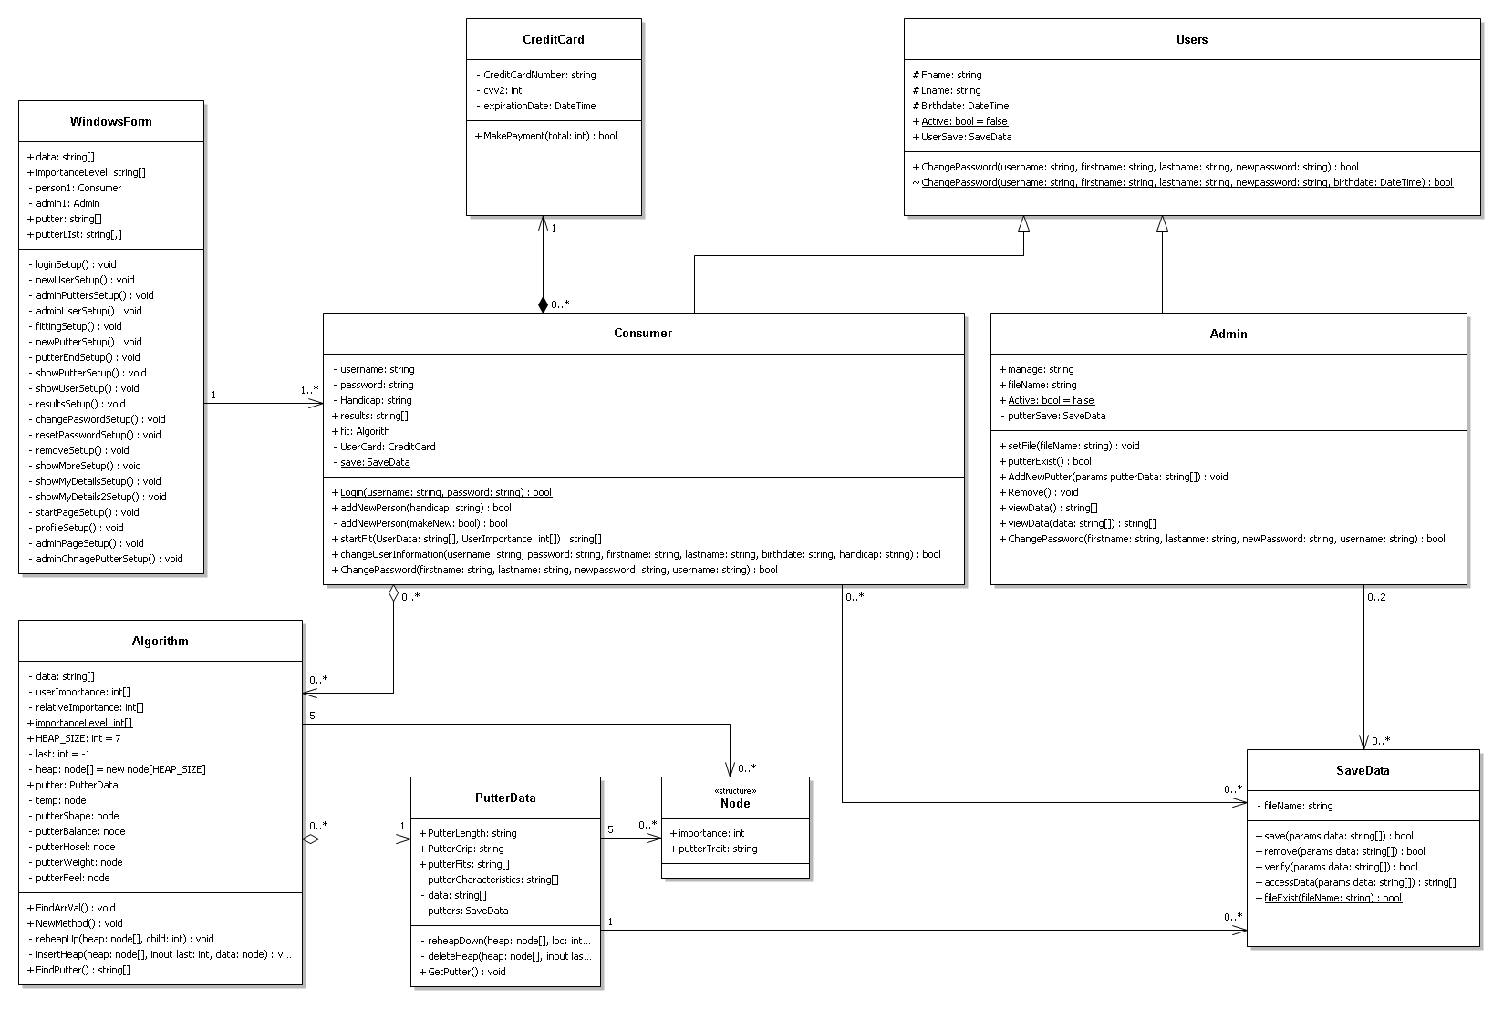
Object Oriented Design
Composition
Inheritance
Aggregation

Slide 4
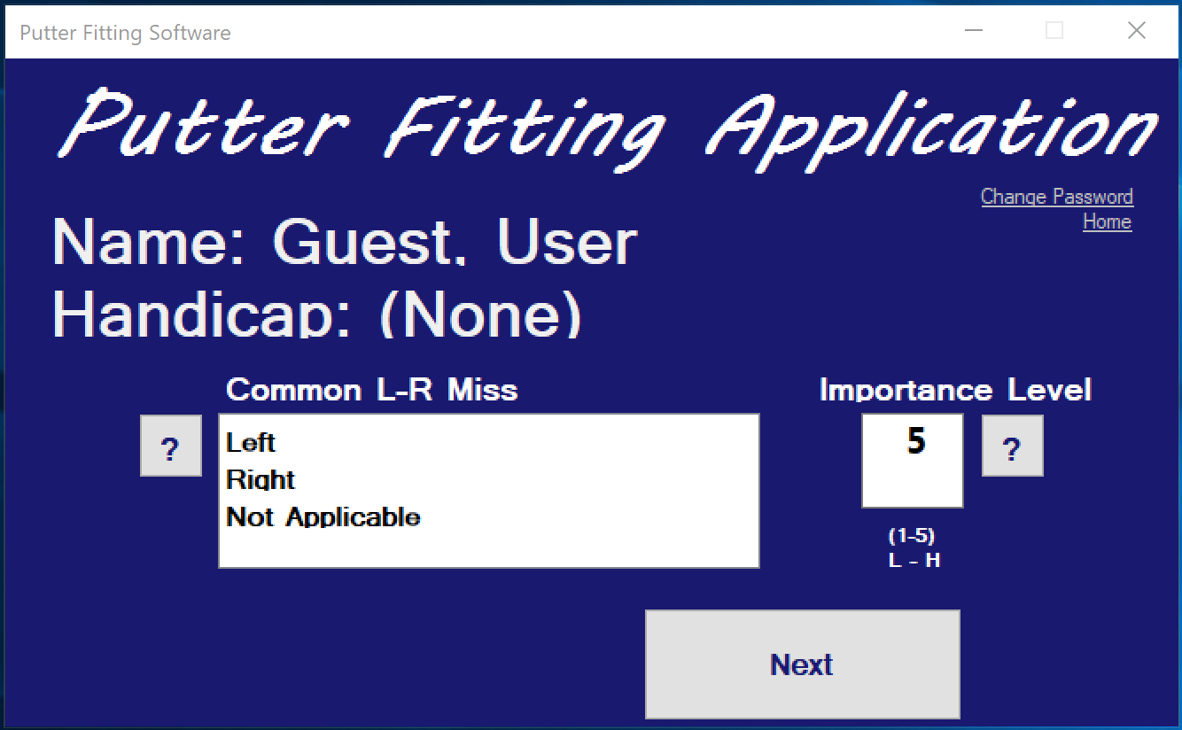
Demo
Login
Fitting
Profile
Admin
Add putter
Manage
View

Slide 5
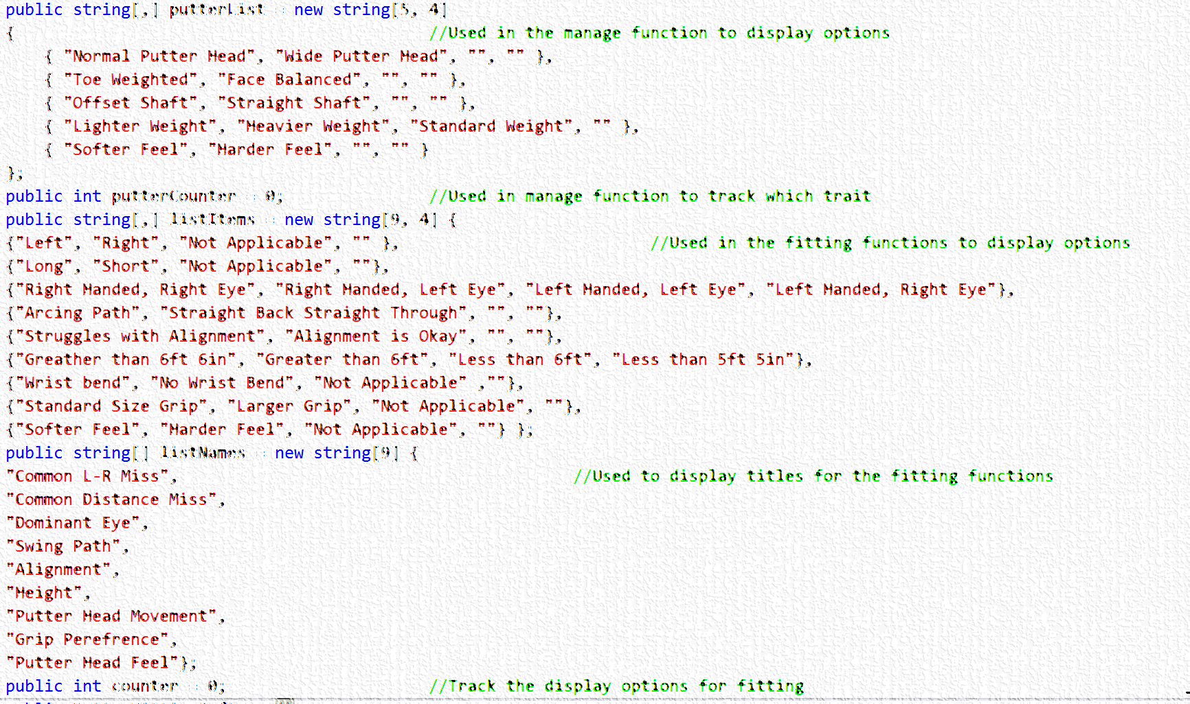
What worked, what didn’t
Had a lot of success
If I had to change something, I would probably change the hard coded traits to be separate classes or enums.

Slide 6
Questions

